Slide 1
Somerset Micro-providers
Releasing Somerset’s Capacity to Care
An introduction to our network of Micro-providers, providing quality flexible care and support to local communities
July 2020
Vicky Chipchase
Senior Commissioning Officer, ASC Community Commissioning

Slide 2
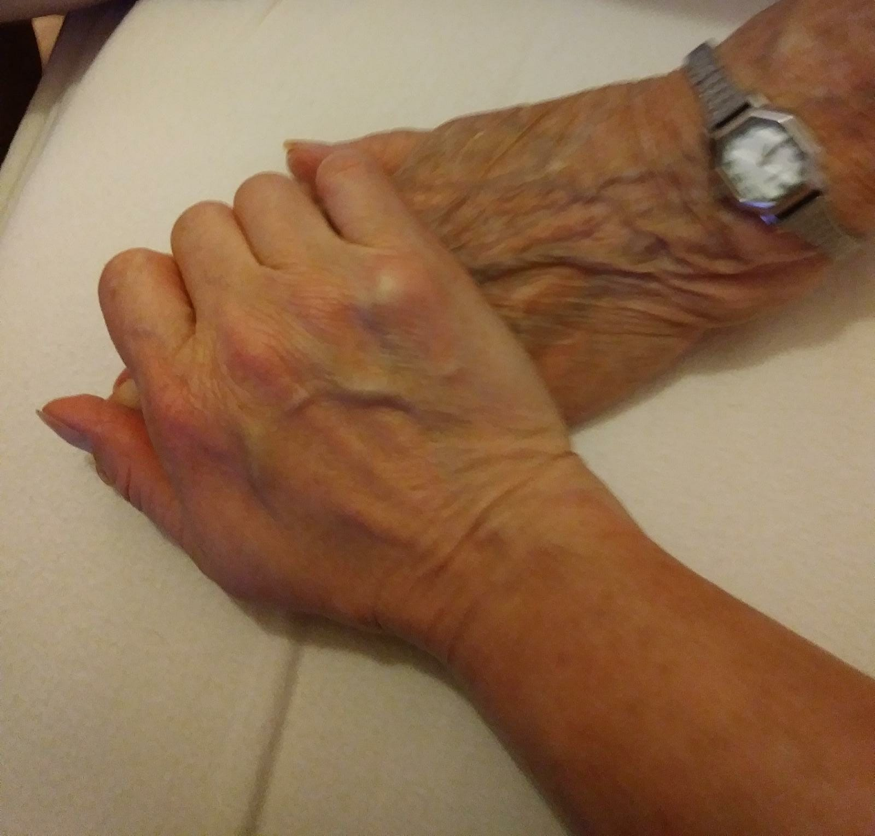
What is a Micro-provider?
A Micro-provider is a small (under 8 fte employees), independent support or service that offers help care or support to local people. People can purchase the services of a Micro-provider directly or through a Direct Payment or Personal Health budget. The Somerset Micro-provider Network is a group of community based providers that are able to provide personal, flexible and responsive support and care to local people that gives them more choice and control over the services they need. Service’s include personal care, domestic help around the home, gardening and social support.
Notes:
What is a Micro-provider?
Micro-providers are providers of very small, community based care and support services.
A micro-provider has eight or fewer paid or unpaid workers and must be totally independent of any larger organisation. Examples of micro- services could include:
Support to keep well, socialise and remain independent
Support to people living in their own homes
Short breaks and holidays
Support to access employment, education and leisure
Day support and help around the home.

Slide 3
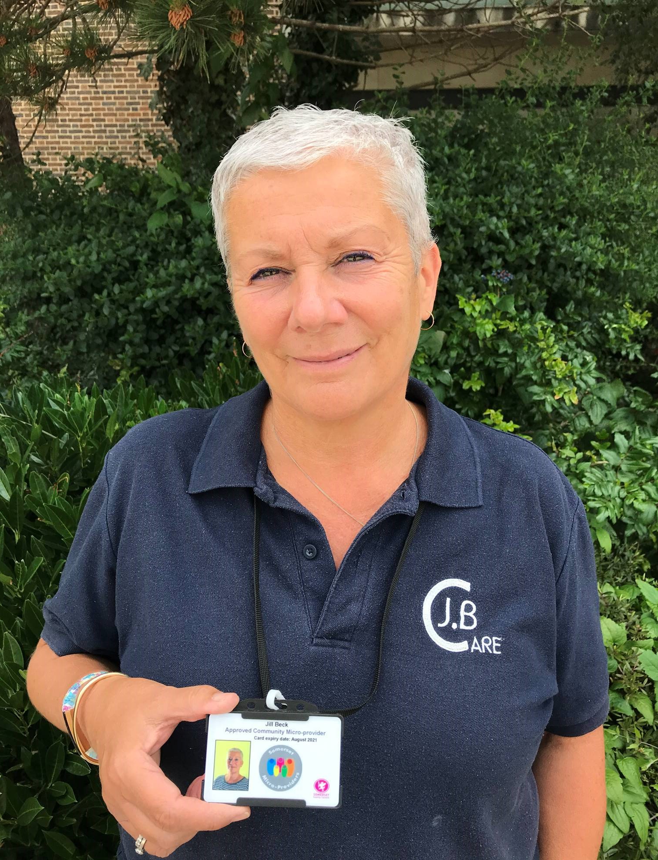
Accredited providers
Becoming a Micro-provider can be an exciting new career or second career option for people with a passion for making a difference in their community.
Somerset County Council has a Somerset Community Micro-enterprise development programme, that gives people the information, advice and support to explore and set up a small service in Somerset. All Micro-providers share a commitment to ‘doing it right’ and provide evidence that they are safe, quality and professional, to be formally accredited by Somerset County Council.

Slide 4
A growing network
The Programme has supported the development of 587 enterprises 371 are formally accredited to provide personal care (and that number’s rising). Collectively they are supporting 3998 older people and deliver 19840 hours of care or support a week.

Slide 5
Are Micro-providers for everyone?
People can independently purchase the service of Micro-providers directly, or if eligible, use their Adult Social Care Direct Payment or their Personal Health Budget. However they pay, individuals are responsible for managing their support directly through the provider(s) to ensure that the service is delivered to meet their individual outcomes. Therefore they are not a suitable option for everyone as people must be able to self-direct their own care.
Notes:
Who are micro-services for?
Micro-services offered by micro-providers are not for everyone. They are a good option for people who:
Can’t get the services or support they want and would like more or better flexible local options
Have a clear idea about the support they need
Are able and happy to take responsibility for organising and managing their own care

Slide 6
How do I find a Micro-provider?
You can find and purchase services from a Micro-provider by looking at the Directory on our Somerset Community Connect website by clicking the link below. You can search using key words e.g gardening, or look for providers within a local area.
https://www.somersetcommunityconnect.org.uk/s4s/WhereILive/Council?pageId=4815

Slide 7
Help to access a Micro-provider
Alternatively should somebody require some support to accessing a Micro-provider then they can contact their local Village Agent through the Community Council for Somerset by visiting: https://somersetagents.org/find-an-agent/ or telephoning: 01823 331222. The Village Agent can help to guide people to the services in their area, however, individuals must select their preferred provider themselves and then manage that relationship there on.

Slide 8
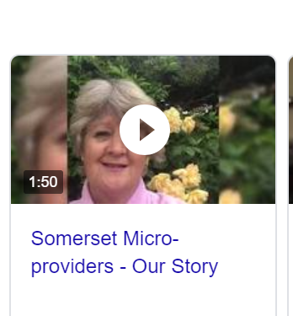
What is like to be a Micro-provider?
Click on the link below to see a video of some our Micro-providers talking about their work.
http://www.somersetloop.org.uk/somerset-micro-providers-our-story-video/

Slide 9
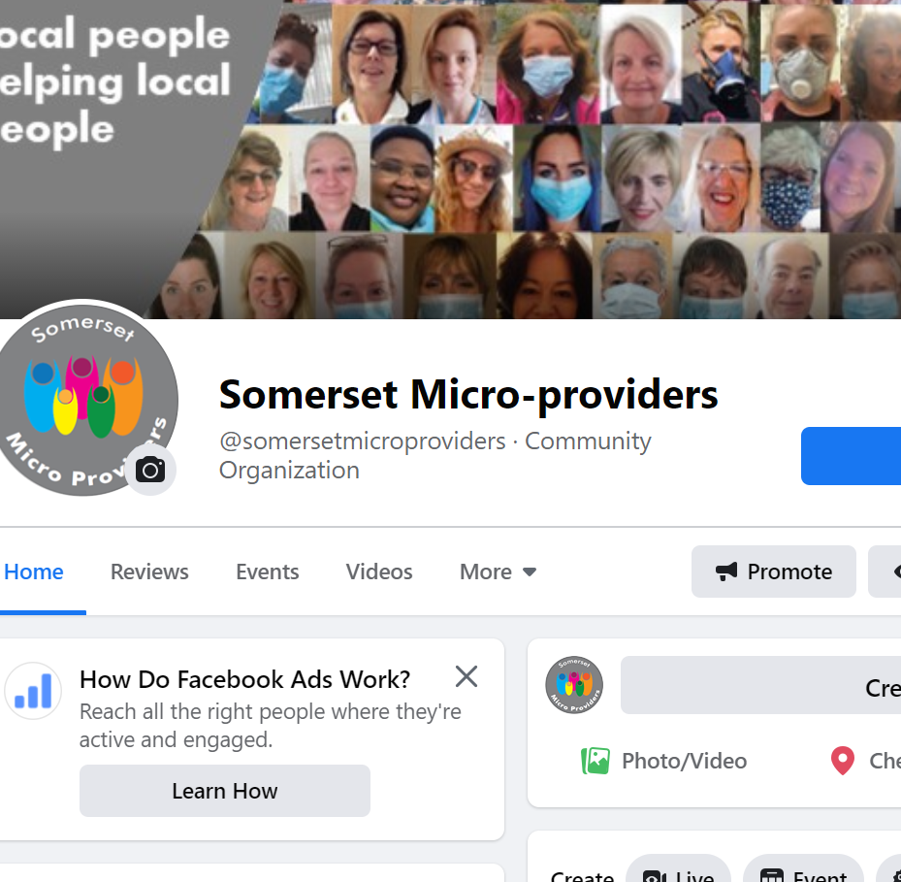
Wanting to be a Micro-provider?
If you know someone who would like to find out more about becoming a Micro-provider, they can visit the Facebook Group to talk to other Micro-providers
https://www.facebook.com/somersetmicroproviders/
Of through our Micro-provider Enterprise Project website at the following location:
https://www.somerset.gov.uk/social-care-and-health/somerset-micro-enterprise-project/#How-to-become-a-micro-provider.

